Slide 1
The Chromium Sandbox on Windows 10
BSides Perth 2019

Slide 2
Intro

Slide 3
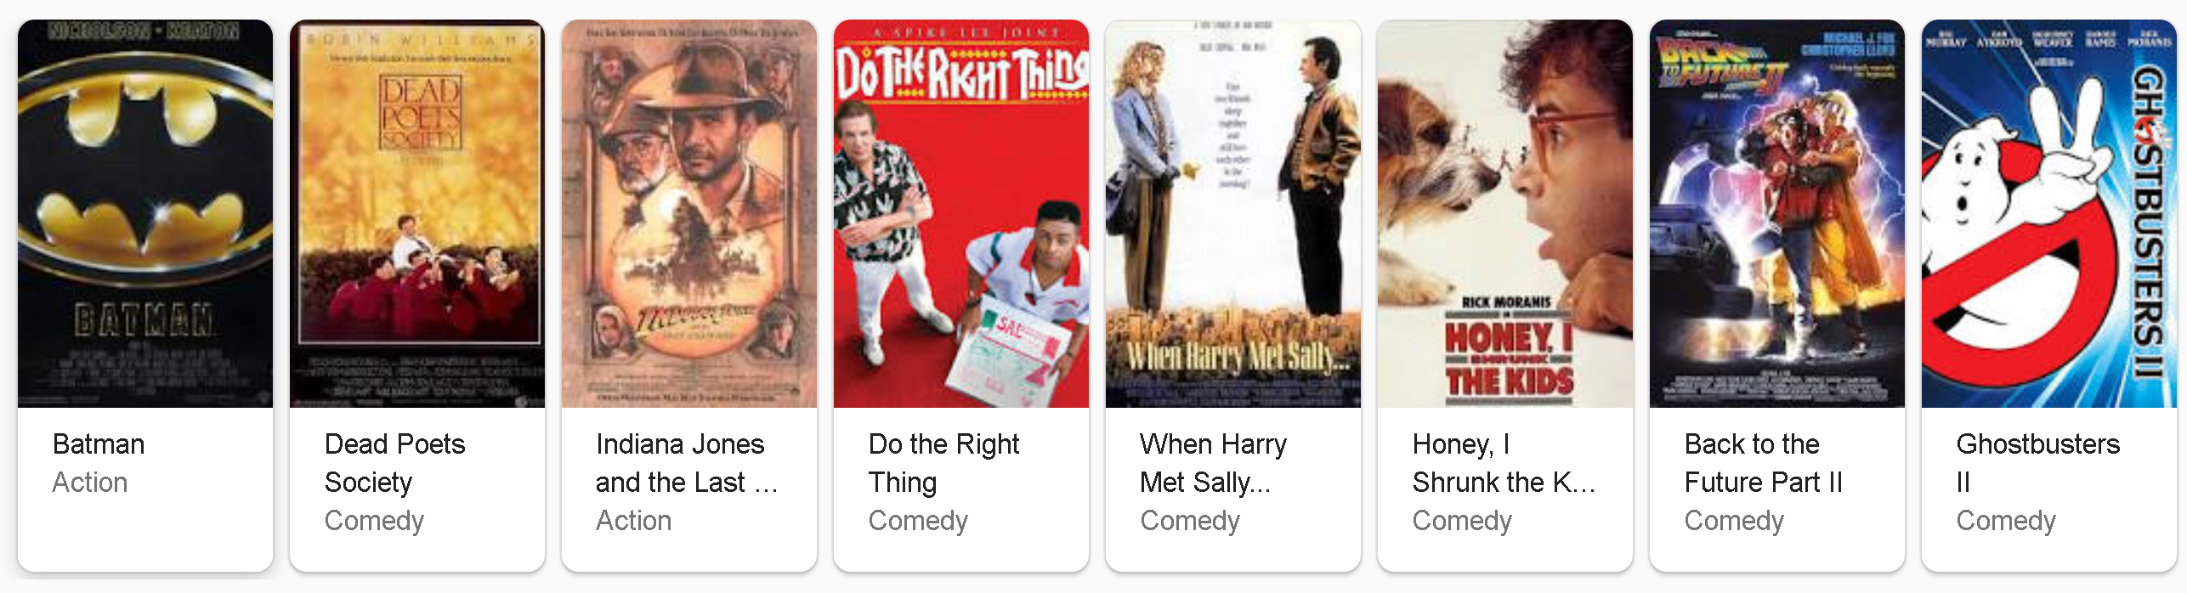





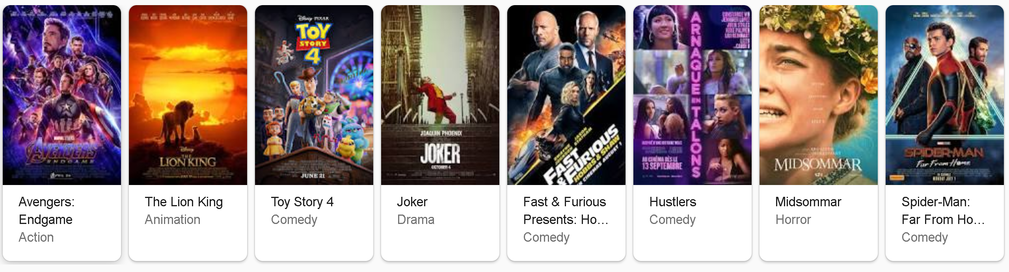
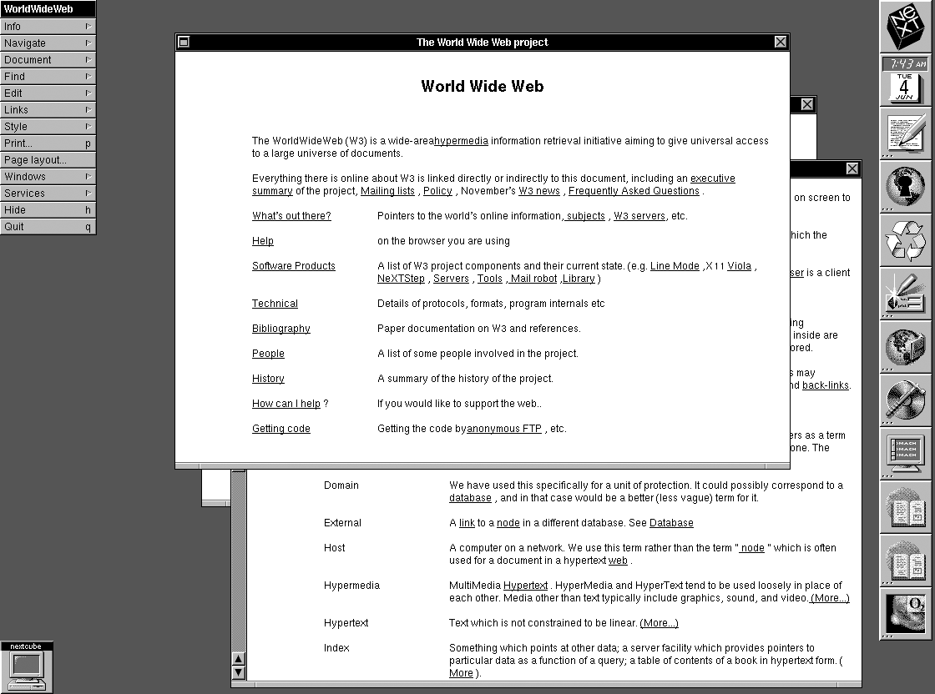



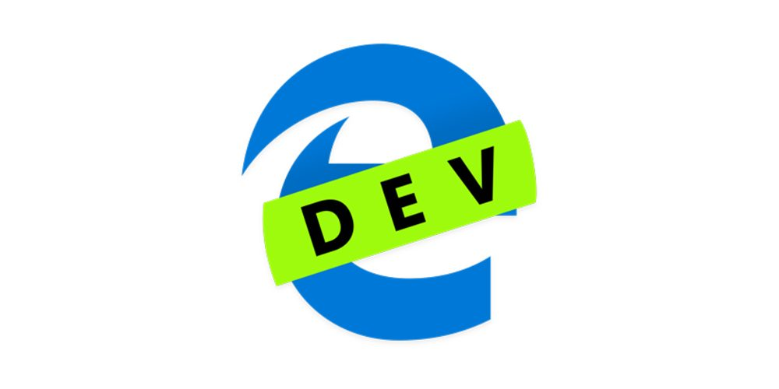
www 1989
Mosaic 1993
IE 1996
Firefox 2004
Edge 2015
30 years!
Nexus 1991
Netscape 1994
Safari 2003
Chrome 2008
Edgeium? 2019

Slide 4
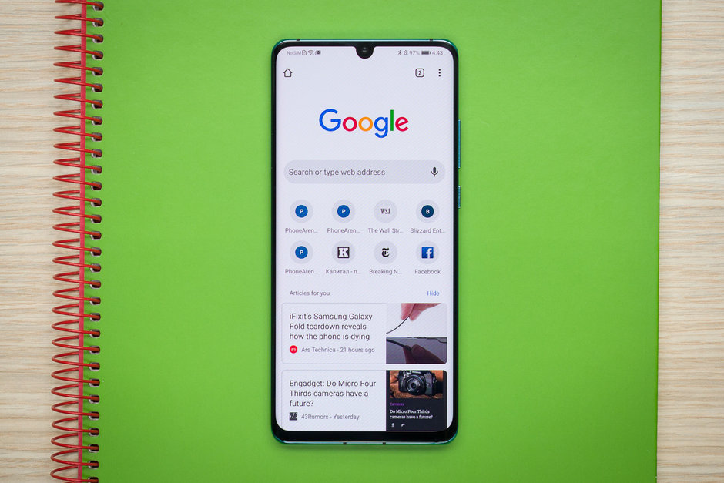
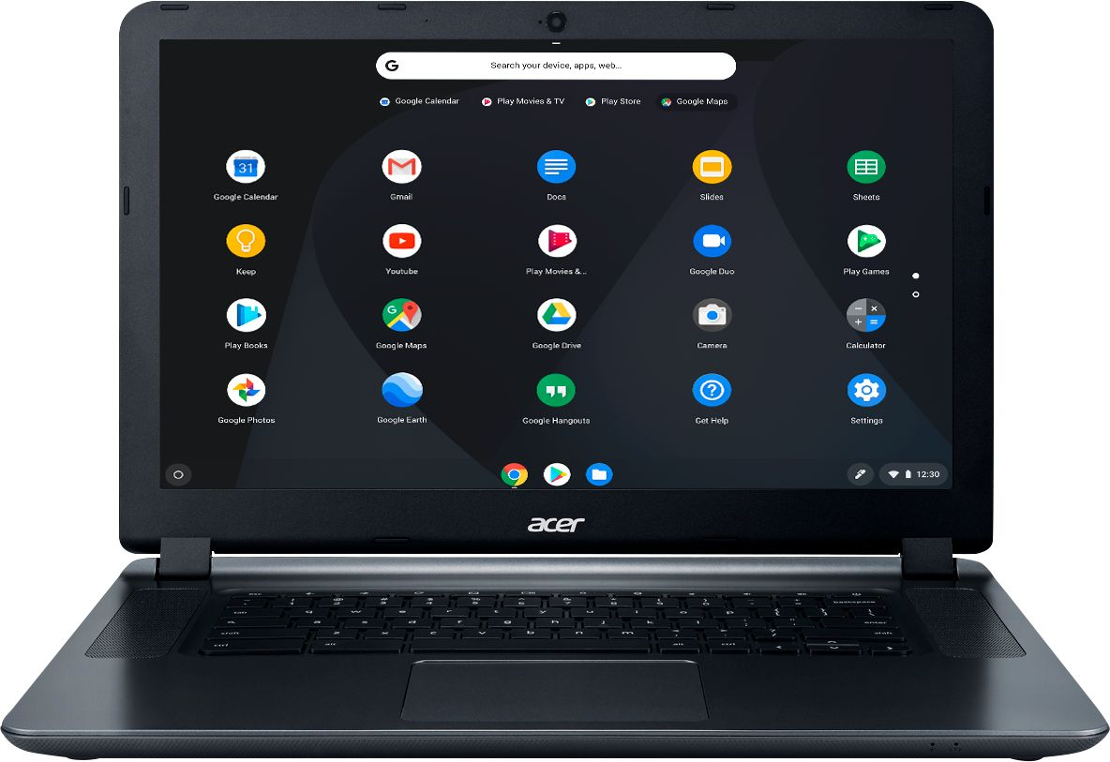

Slide 5


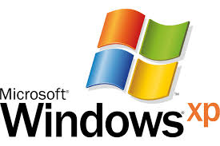
Computer virus era
90’s and 2000’s …
Outdated browser
Runs Java and Flash
Outdated Windows
Runs everything as Admin

Slide 6
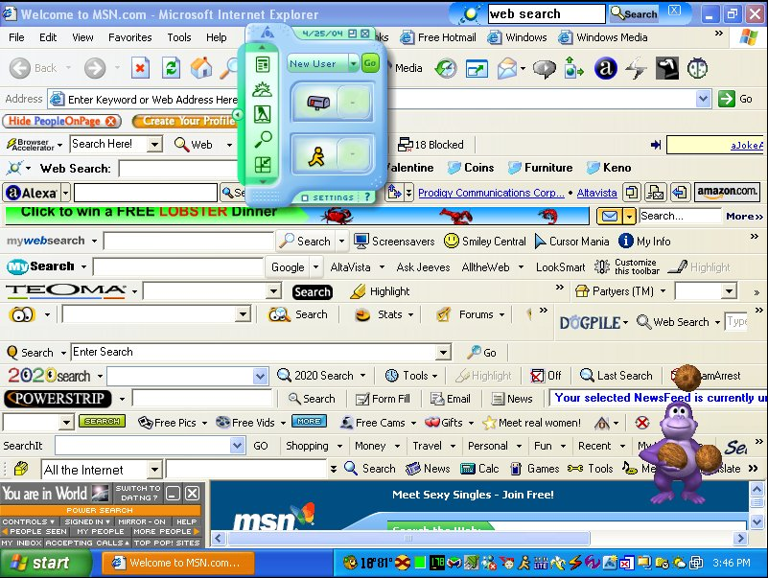
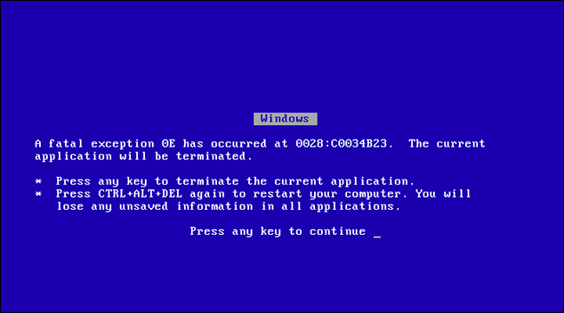
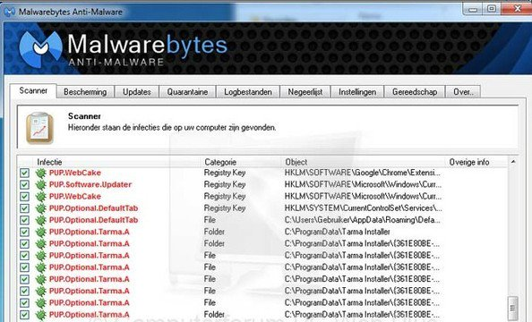


Slide 7
Remote Network service exploit
O.S
Attack surface
Exploit
Network exploit may have hurdles
Limitations for grooming memory
Challenges with mitigations and stability
Userland mitigations
Remote Browser client-side exploit
Attack surface
Attackers are at an advantage
Can exhaust many web features to groom memory
Can use JavaScript features/types

Slide 8
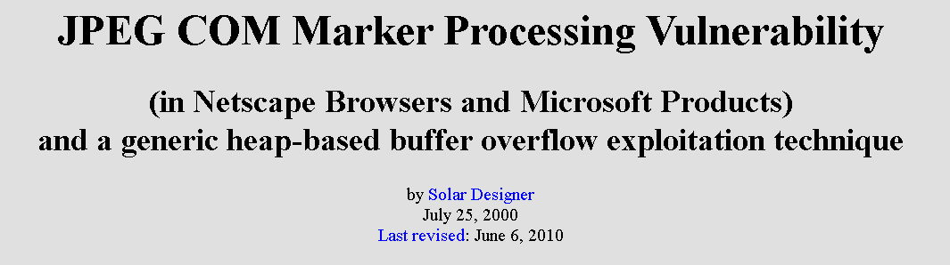

Slide 9
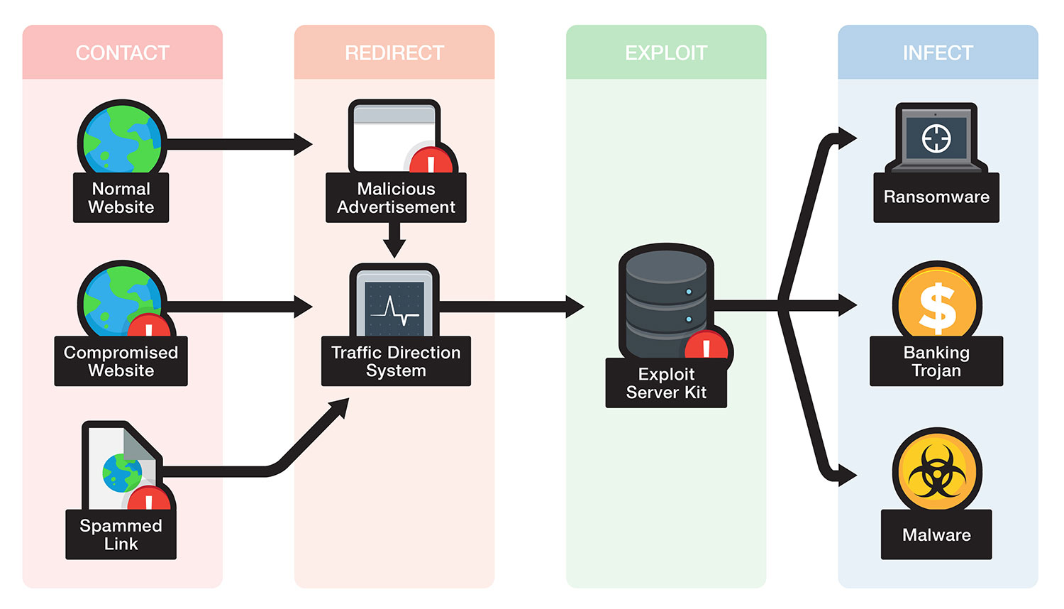
Fast forward several years…

Slide 10
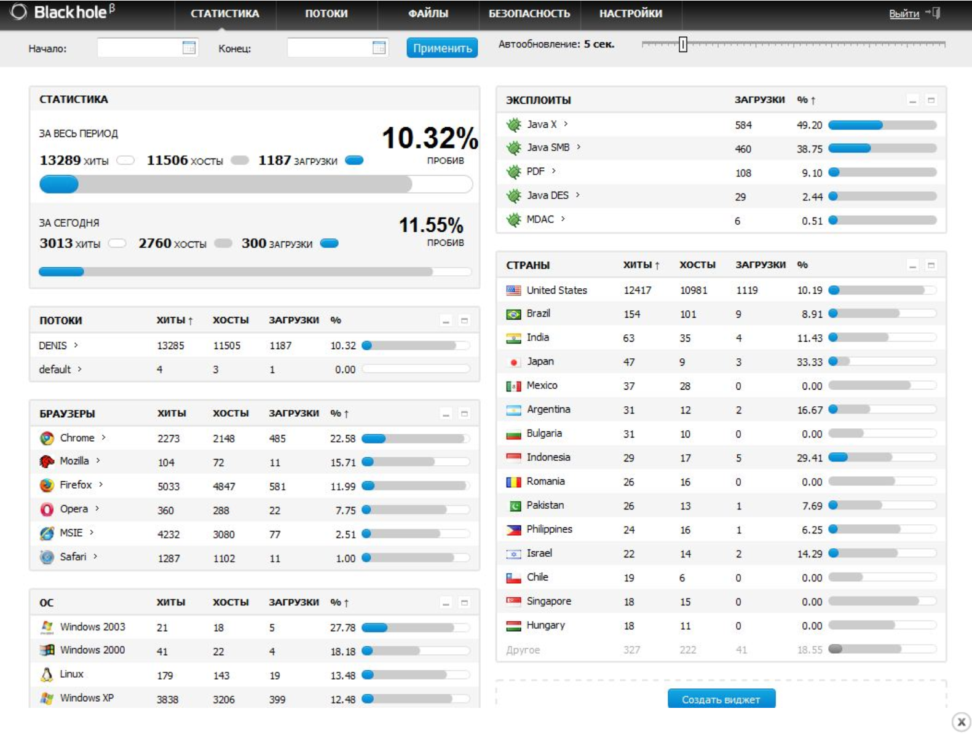
First spotted in 2010, BlackHole is commercial crimeware designed to be stitched into hacked or malicious sites and exploit a variety of Web-browser vulnerabilities for the purposes of installing malware
Not long after that story, the individual with whom Paunch worked to purchase those exclusive exploits — a miscreant who uses the nickname “J.P. Morgan” — posted a message to the Darkode[dot]com crime forum, stating that he was doubling his exploit-buying budget to $200,000.
Paunch contracted with a third-party exploit broker who announced that he had a $100,000 budget for buying new, previously undocumented “zero-day” vulnerabilities.

Slide 11
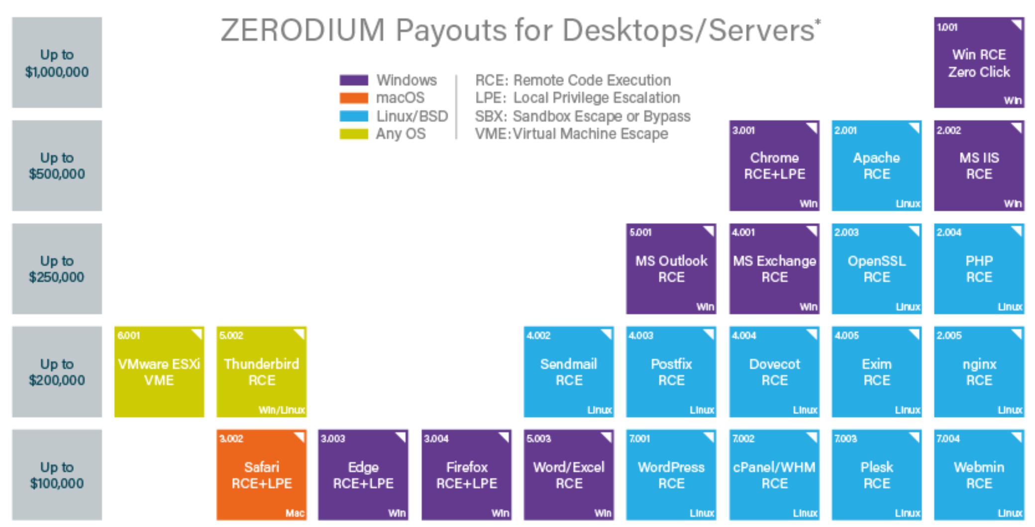
Pwn2Own versus Zerodium

Slide 12
Goals for this talk
Summarise the main attack vectors for full browser exploit chains
Give some appreciation for the dance between Google & Microsoft
In particular, huge kudos to Forshaw for his rather amazing research
Allow for everyone to understand in general browser sandboxing and where things are at
On one end, a bunch of things will be glossed over, and on the other end probably some acronyms and terms that may get lost to some
Provide hints and references for those interested in deep diving
Even though this is focused on Windows sandboxing, it has to be relatively general due to time – we’re touching many specific areas of research

Slide 13
Chromium Sandbox Intro

Slide 14

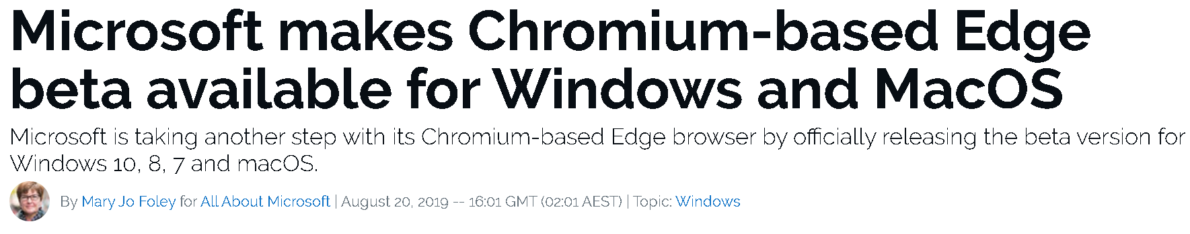

Slide 15

Launched in 2008
Open-source, developed by Google
Multi-process architecture
Written in C/C++ and JavaScript
x86 and ARM
Blink since 2013 for its engine
V8 since inception for its JS engine

Slide 16
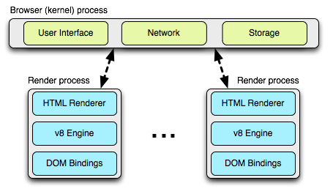

Slide 17
The Google Chrome Sandbox
A sandbox is a security control and a realist software design approach that accepts that exploitable vulnerabilities will happen, but it’s possible to contain the risk by limiting access for the process
The multi-process architecture gives an opportunity to apply policies to “sandbox” a process
The Chromium sandbox itself is platform agnostic – it provides a bridge to specific O.S security controls, e.g. Windows 10
Policies are enforced from the parent “broker” or “browser” process and applied to a “target” sandbox process

Slide 18
gpu
gmail
chrome.exe
widevine
netflix
flash
random
OS
Browser
Sandboxes

Slide 19
Applying Policies
For each target process, restrictions are enforced:
TargetPolicy::SetTokenLevel()
TargetPolicy::SetJobLevel()
TargetPolicy::SetIntegrityLevel()
TargetPolicy::SetDesktop()
MitigationFlags can also be applied for exploit and containment controls
The AddRule() function can then allow access to a number of securable object types, i.e. files, named pipes, registry hives, shared memory, etc.
A Securable Object is an object in Windows that can have a Security Descriptor – security information such as owner, group, a discretionary ACL for who can and can’t access the object, etc.

Slide 20
Windows Policies – IL’s and Tokens
Integrity Levels
Restricted Tokens
In Windows Vista as a form of Mandatory Access Control of Securable Objects
Low Integrity level process was the sandbox for Protected Mode
User Interface Privilege Isolation (UIPI) to apply to window messages in a desktop
The most common IL’s:
System
High
Medium = Normal User App
Low = Sandboxed
Untrusted = Nothing
A special type of token in Windows that restricts access to securable objects
Applies a deny-only attribute to security identifiers (SID’s) making it useless
Has some known limitations, such as not supporting FAT file-systems

Slide 21
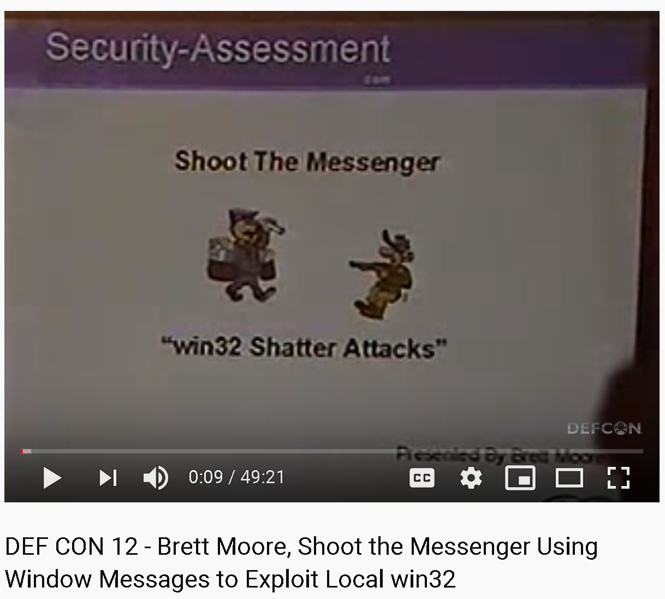
Windows Policies – Jobs and Desktops
Job Objects
Alternate Desktops
A group of processes that can also define a limit
Forbids changing desktops
Prevents reading/writing to clipboard
Prevents access to ATOM table, USER handles, etc.
Prevents sending messages across desktops (Shatter attacks)
Forces the sandbox to have its own dedicated desktop (not visible/interactive)
Isolates the process to prevent snooping

Slide 22
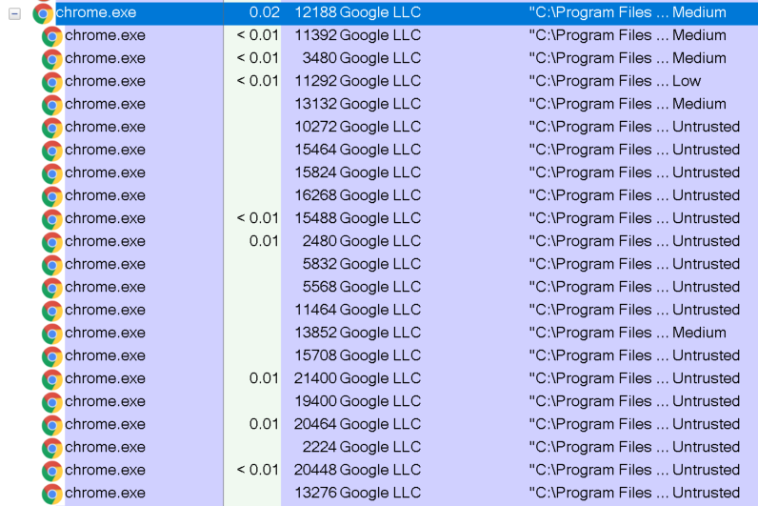
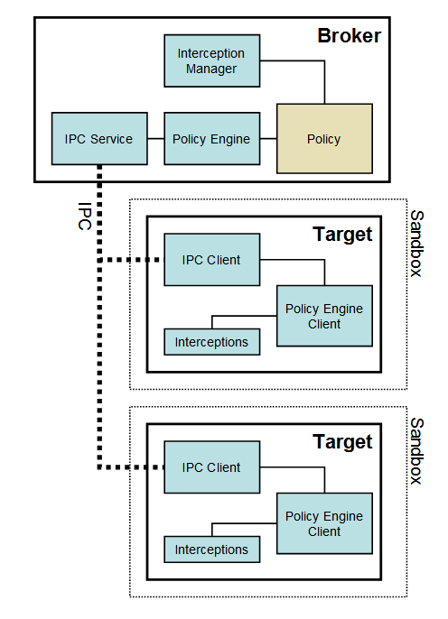
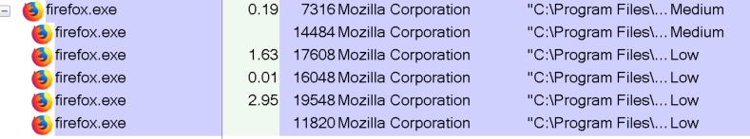
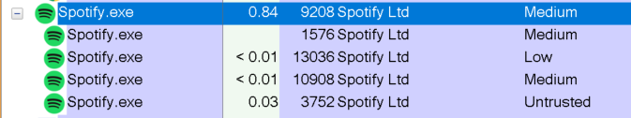
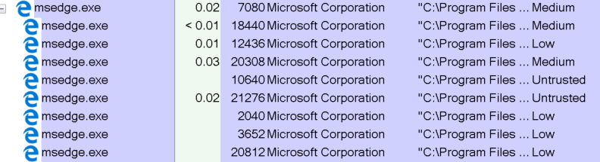
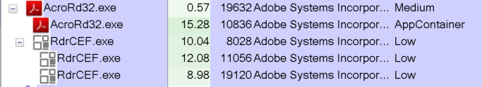

Slide 23
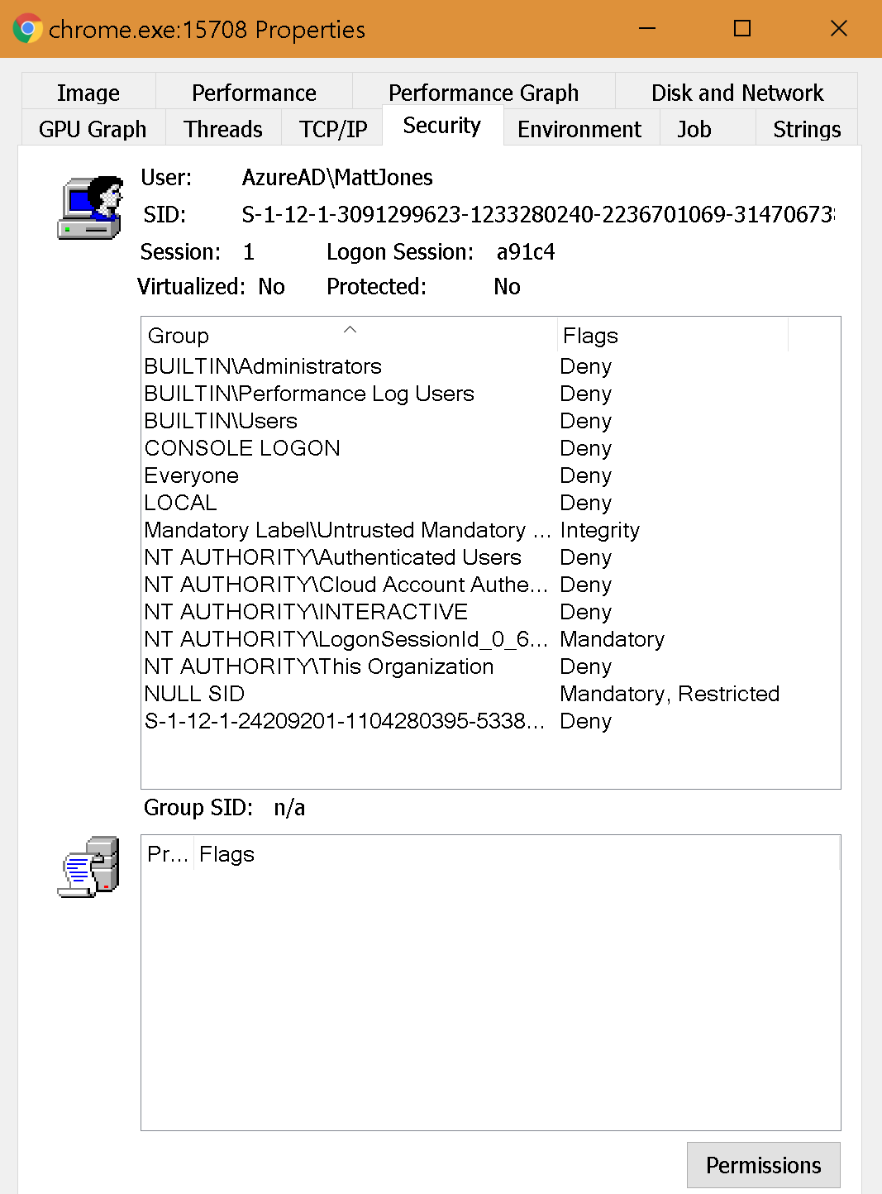
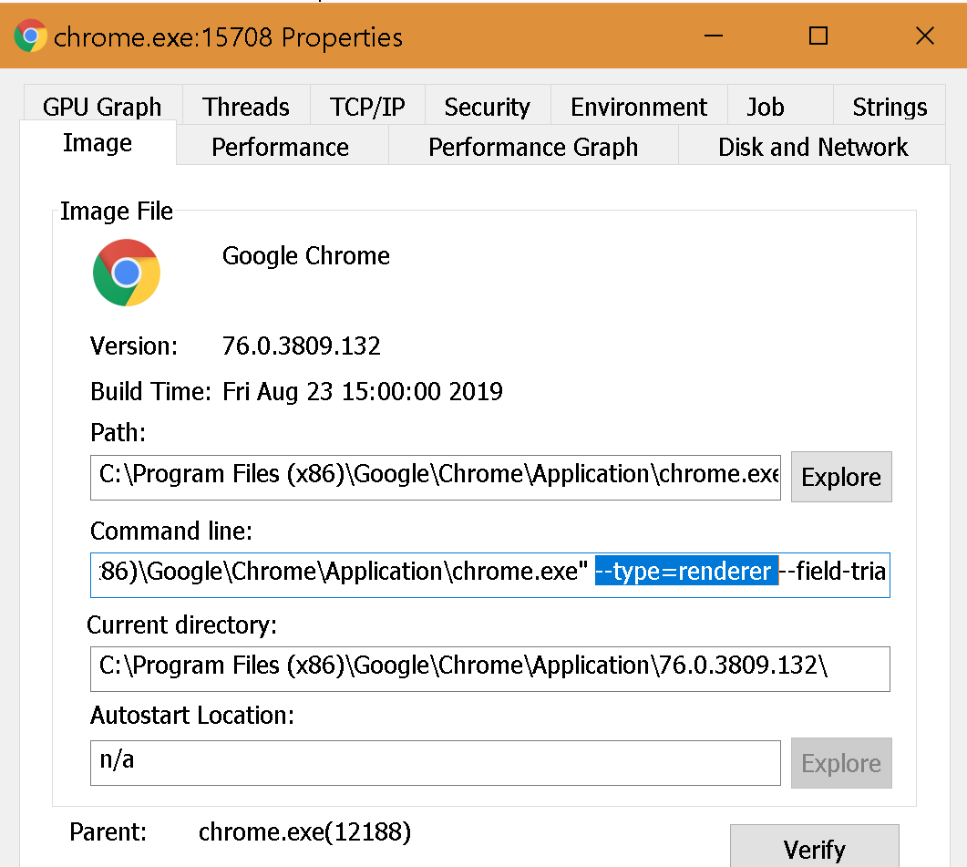
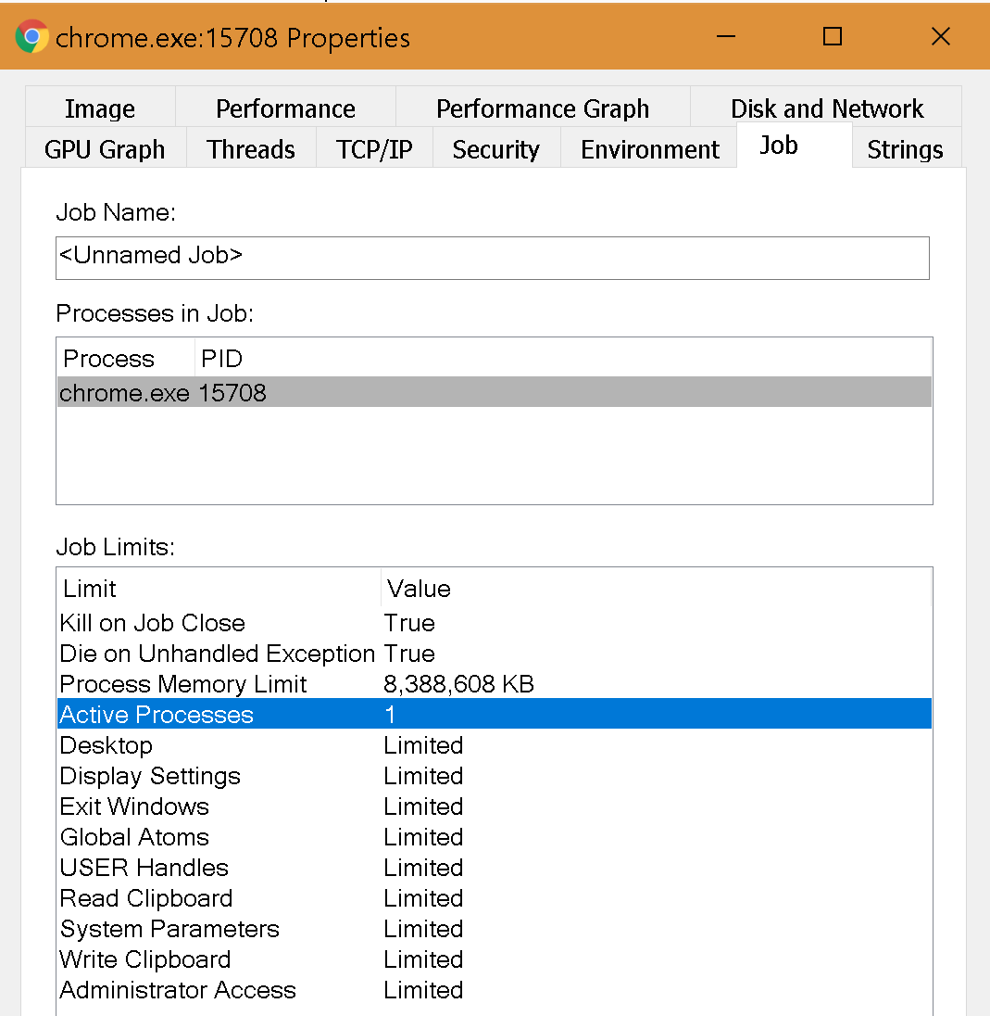

Slide 24
Today’s Agenda
Intro
Chromium Sandbox Intro
Sandbox Break-Ins
Sandbox Escape via Windows Privilege Escalation
Sandbox Escape via Browser IPC
Conclusion

Slide 25
Sandbox Break-ins

Slide 26
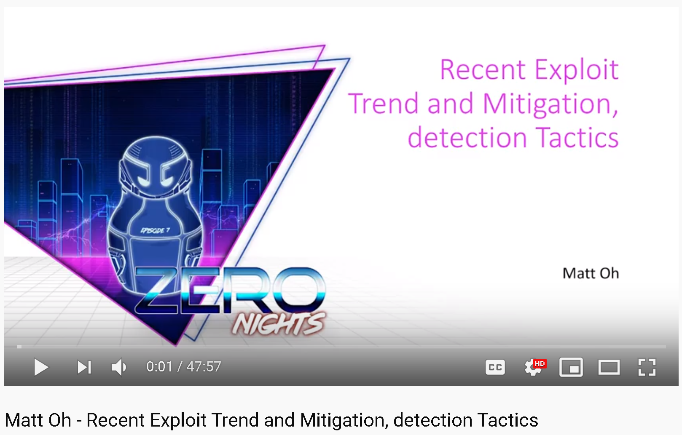
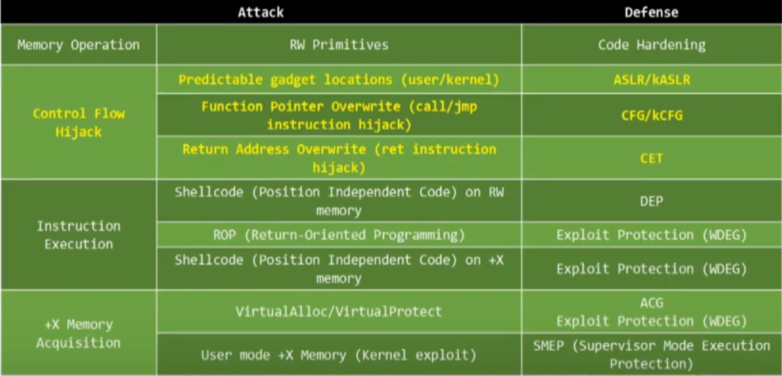
Exploit Mitigations
PartitionAlloc for internal memory management mitigations
Several exploit mitigations can be applied to processes:
Address Space Layout Randomization (ASLR)
Data Execution Prevention (DEP)
Structured Exception Handler Overwrite Protection (SEHOP)
A number of mitigations have complimenting flags, e.g.:
MITIGATION_RELOCATE_IMAGE_REQUIRED
MITIGATION_BOTTOM_UP_ASLR
MITIGATION_HIGH_ENTROPY_ASLR
Control Flow Guard is not a mitigation and must be compiled via clang or Visual Studio

Slide 27
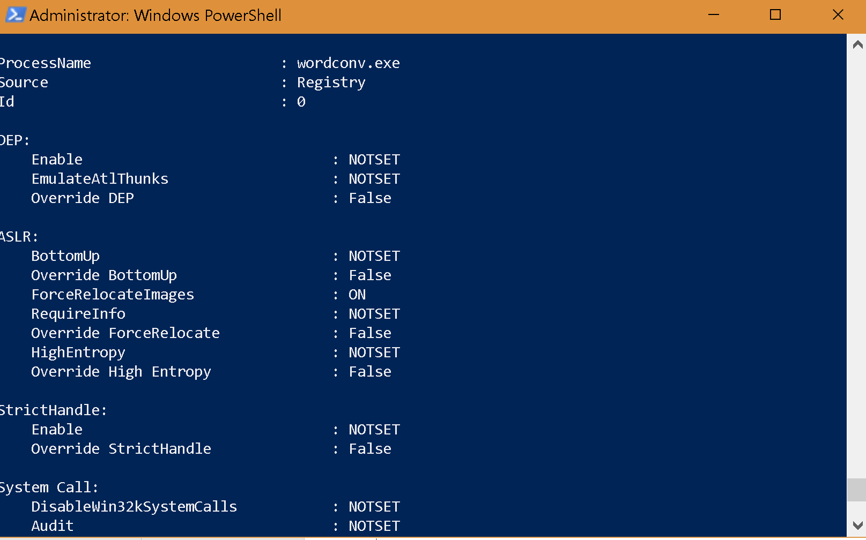
Initial Foothold Mitigations
Several mitigations to help strengthen a process from various attacks:
Stricter checking of handles
Restricting DLL search orders
Forbidding loading dynamic code
Ensuring binaries are signed
And many others
There are a few others that will be covered more later…
If you can create a new process during post-exploitation, some policies are not inherited by the new process, including Dynamic Code, Binary Signatures, and Disabling Non-system Fonts
In PowerShell you can use Get-ProcessMitigation

Slide 28
SBX via Windows Privesc

Slide 29

gpu
gmail
chrome.exe
widevine
netflix
flash
random
OS
Browser
Sandboxes

Slide 30

Kernel
privilege
System
User
Sandbox
Exploit 1: Compromised renderer

Slide 31
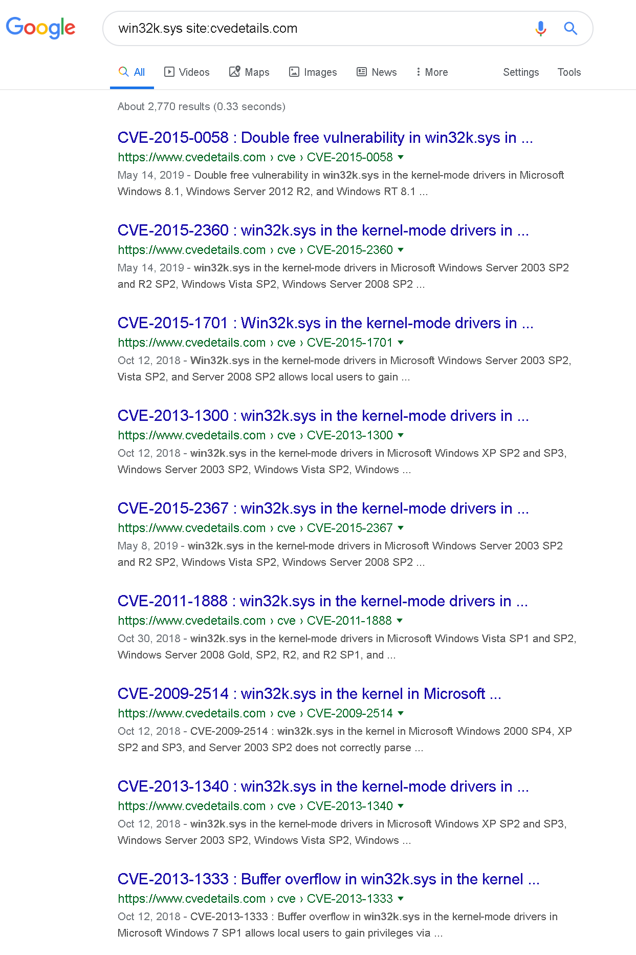
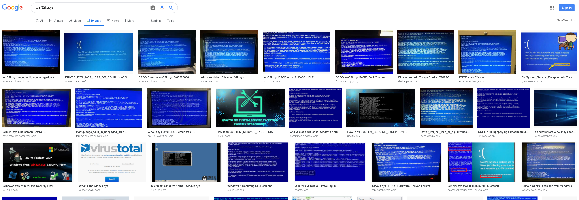

Kernel - Win32k.sys
A big and old kernel-mode driver, think:
GDI – graphics output, drawing library
USER – handles input and UI elements
Over 1000 API’s and a huge attack surface
Over 60% of Windows kernel vulns since 2010 are in Win32k.sys
Used as the SBX vector for multiple Pwn2Own submissions
Identified as sandbox escape vector for multiple in-the-wild exploits
A “Win32k filter” was supported for Edge to limit attack surface

Slide 32
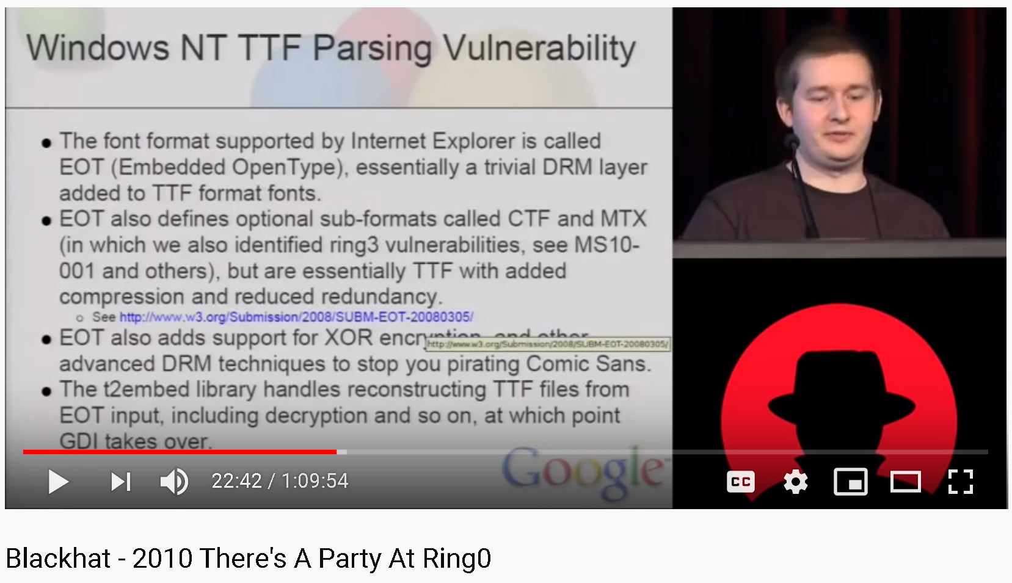
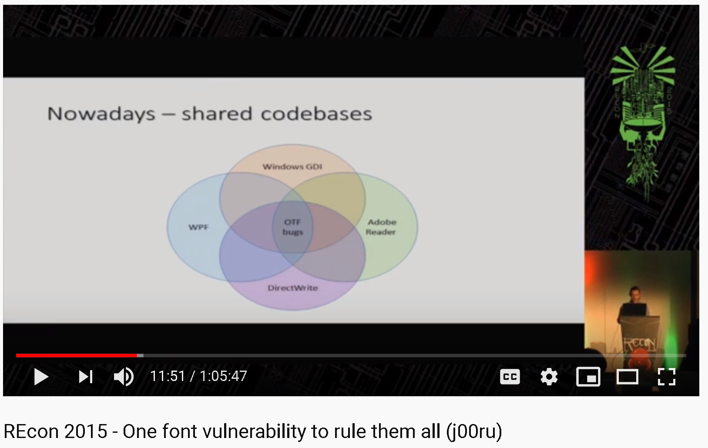
Win32k.sys - Fonts
Originally font parsing happened in kernel – this was bad
See There’s a Party At Ring0 demonstrating reaching TTF parsing kernel attack surface via @font-family
PostScript Font security by j00ru
Font parsing now happens in Fontdrvhost.exe, an AppContainer
Win10 introduced MITIGATION_NONSYSTEM_FONT_DISABLE that prevents a process from loading a non-system font

Slide 33
Win32k.sys - Fonts
Kernel
System
User
Sandbox
Exploit 1: Compromised renderer

Slide 34
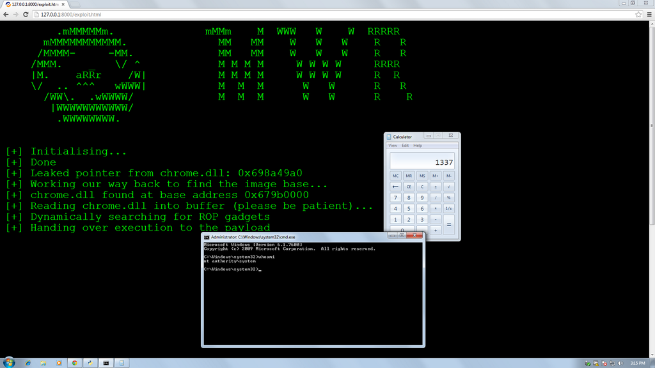
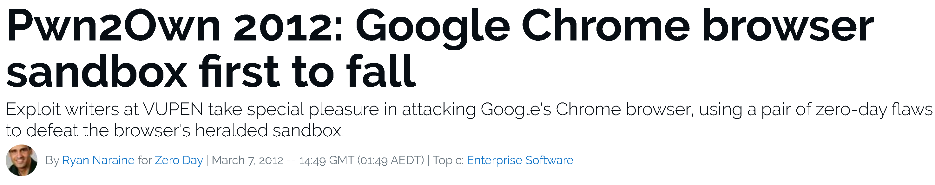
Kernel - Win32k.sys – Pwn2Own

Slide 35
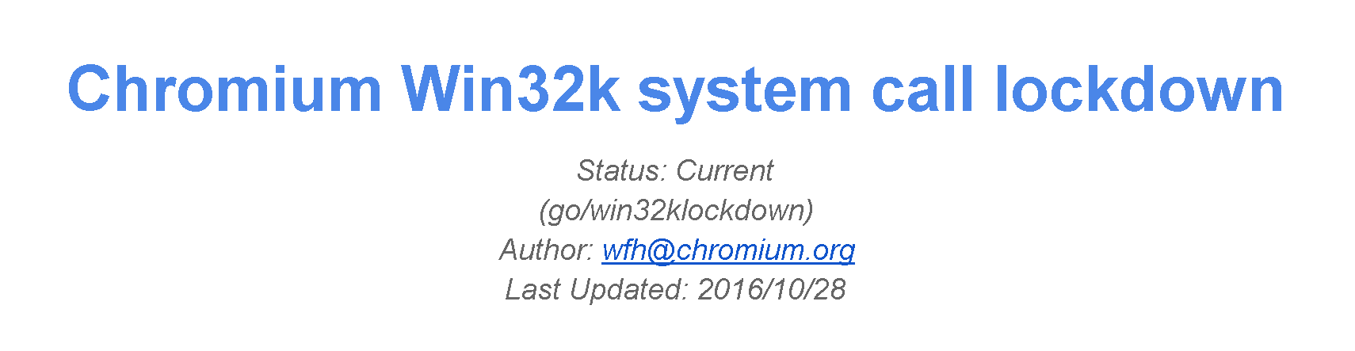
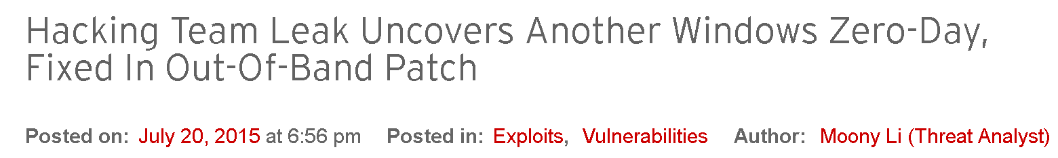
Win32k.sys – Lockdown in Chromium
Windows 8 brought a new process mitigation WIN32_LOCKDOWN
Applied first to the renderer process, later followed by Flash
Read Breaking the Chain by Forshaw to appreciate the engineering efforts required
Completely kills the Win32k attack surface if applied

Slide 36
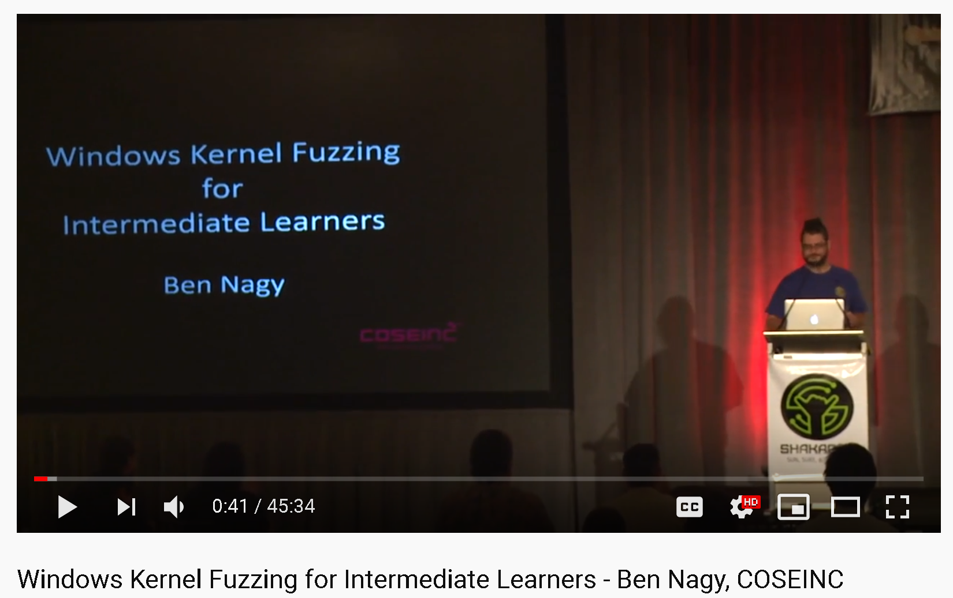
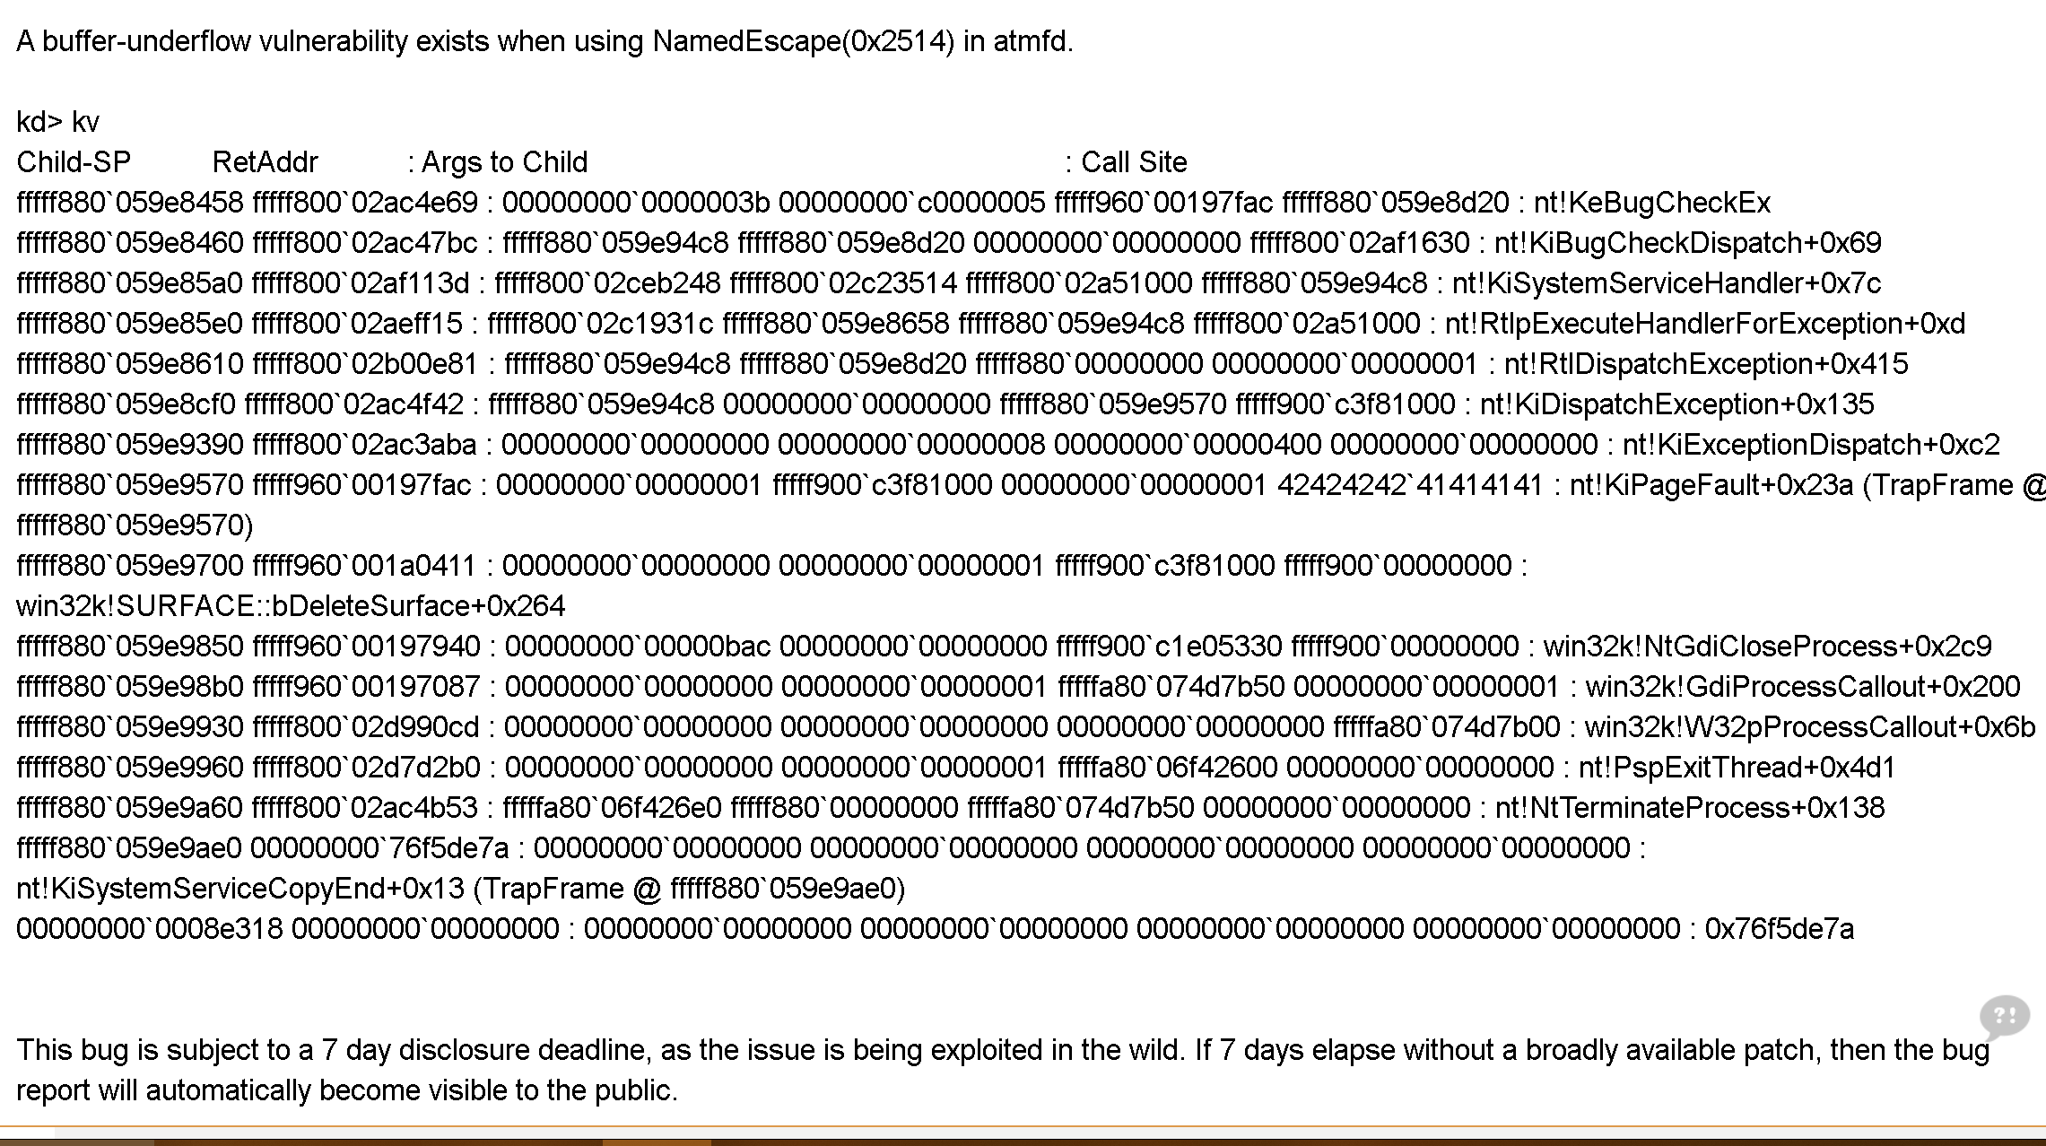
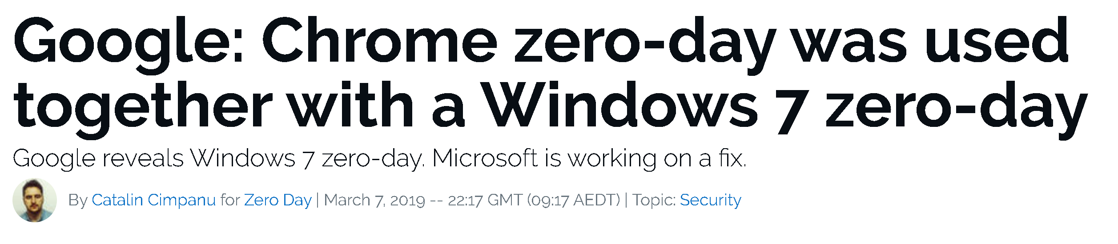
Kernel - Win32k.sys - 2019

Slide 37
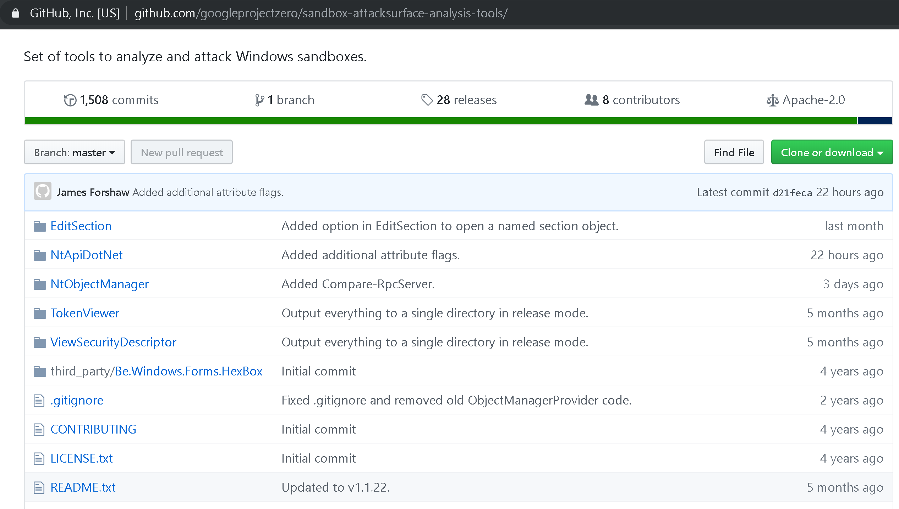
Google Sandbox Attack Surface Analysis Tools
Developed by James Forshaw since around 2014
Primarily PowerShell, however a number of .NET applications
Has been incredibly effective for highlighting attack methods that has (sometimes) resulted in Windows 10 security enhancements
NTObjectManager provides PowerShell Cmdlets that also allow enumerating different objects – devices, services, processes, files, registry keys, ALPC ports, named pipes, etc.
Get-AccessibleService –ProcessIds [pid]
Filter by piping Where-Object { $_.... }
Dump full fields by using Format-List * or Format-Table *

Slide 38
Kernel
Devices
Files
Registry
ALPC ports
Named Pipes
Events
Semaphores
Tokens
Desktops
etc.
System
Services
User
Processes
Sandbox

Slide 39
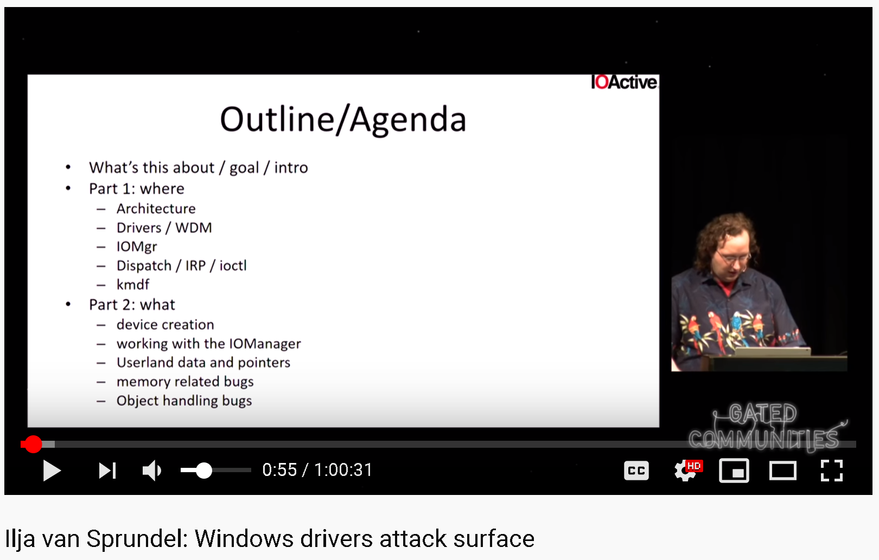
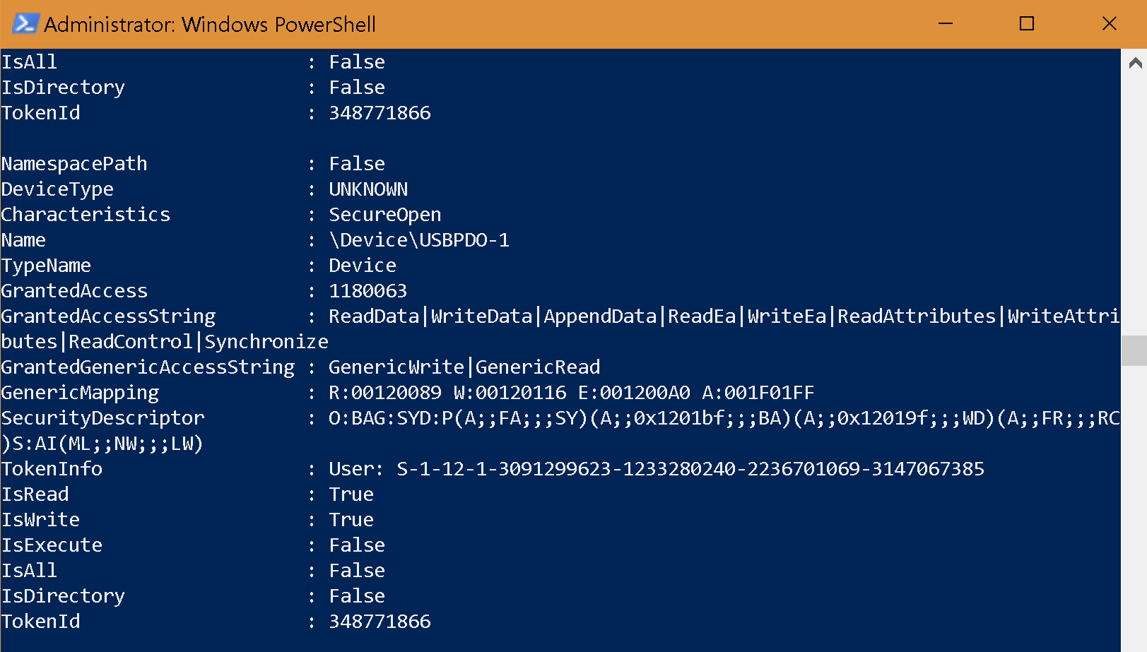
Device Drivers - Kernel
get-accessibledevice \Device -processids [pid] -accessrights GenericWrite
Device Drivers can be *horrible* from 3rd party vendors
AFD.sys is ~70 IOCTL’s, the default Ring 0 entry-point to Winsock
\\Device\AFD\Endpoint
Around 500kb
Can allow creating raw sockets
Device path security is from the kernel, but namespace has to be by the driver

Slide 40
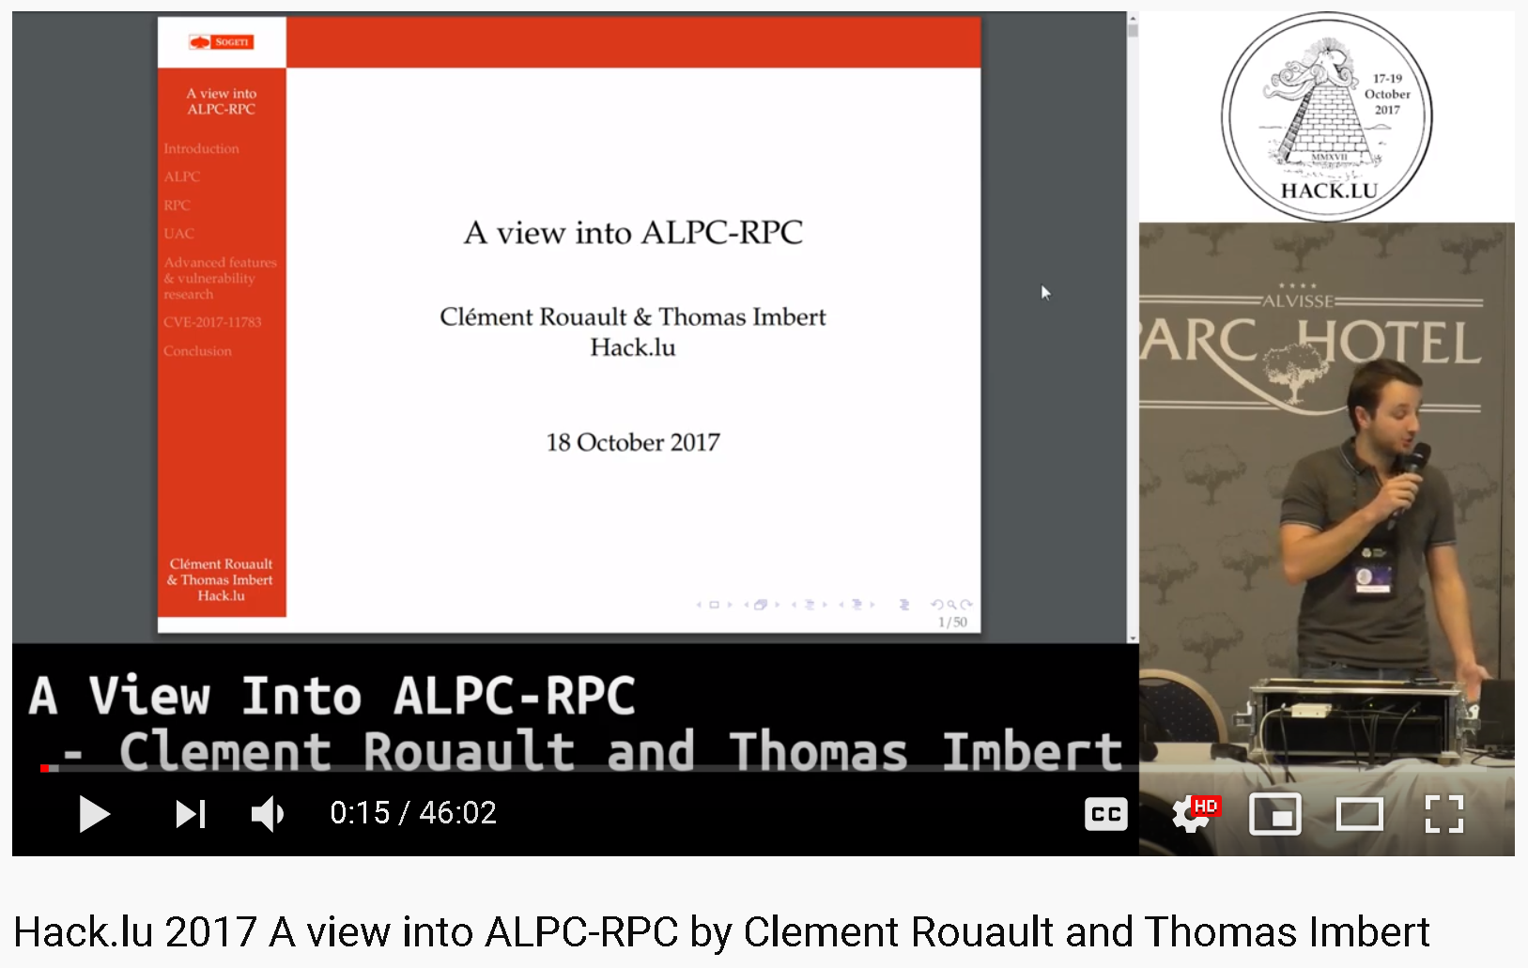
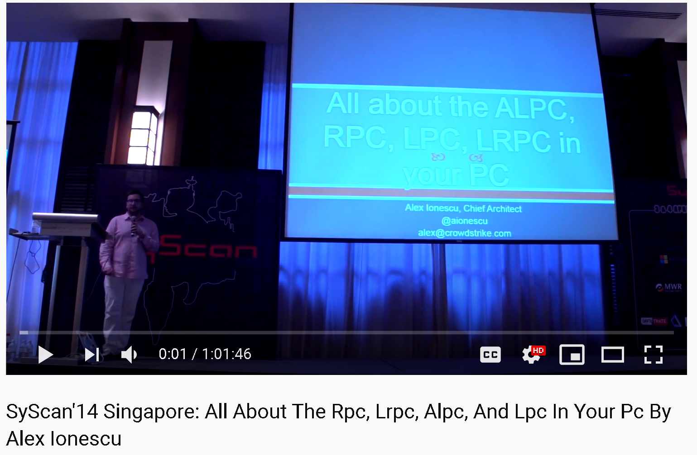
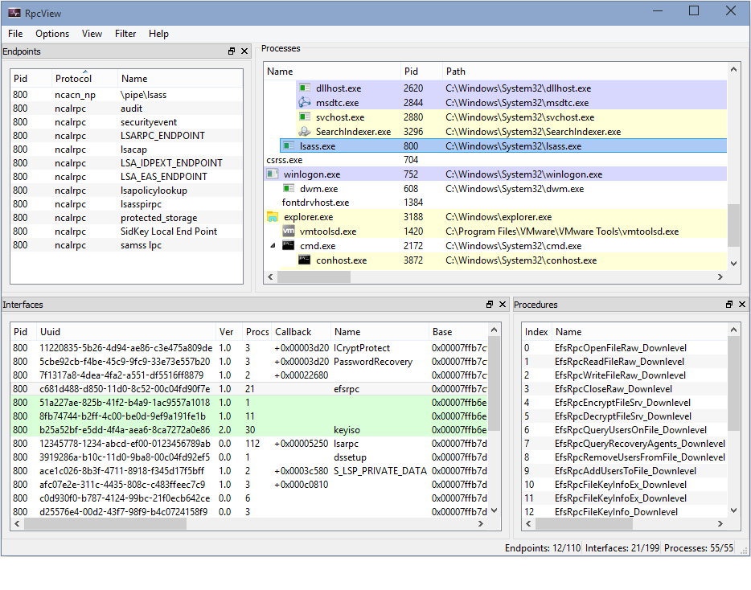
RPC and Named Pipes
Get-AccessibleALPCPort and Get-AccessibleNamedPipe
A Low IL process can access a RPC server with a NULL security descriptor, whereas this is forbidden by an AppContainer
RPC servers are quite extensive attack surface from Windows 10 but also 3rd party (e.g. OEM’s)
Vulnerabilities more or less = SYSTEM
Recommended reading:
SandboxEscapers blog: Reversing ALPC: Where are your windows bugs and sandbox escapes?
James ForShaw: Finding Windows RPC Client Implementations Through Brute Force

Slide 41
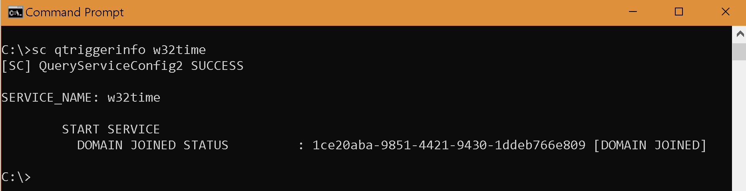
System Services
Get-AccessibleService
Approx. 25% of Windows 10 services start automatically
Starting a service can help create new accessible objects
See Firefox Maintenance service advisory mfsa2015-84
The remaining are triggered or started manually
sc qtriggerinfo <service>

Slide 42
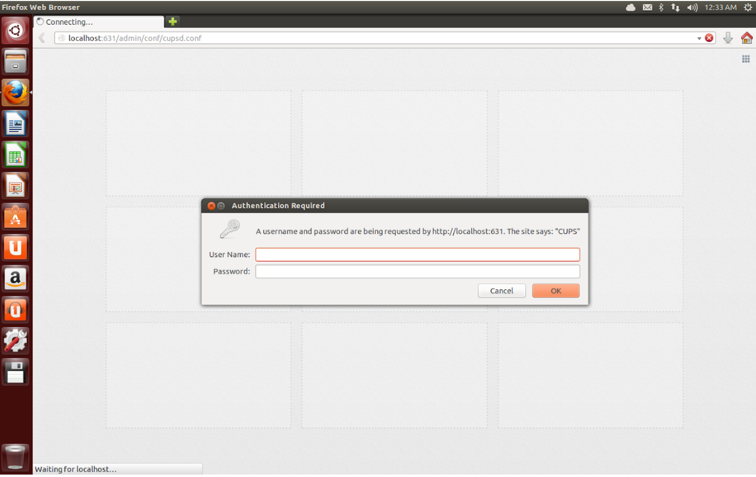
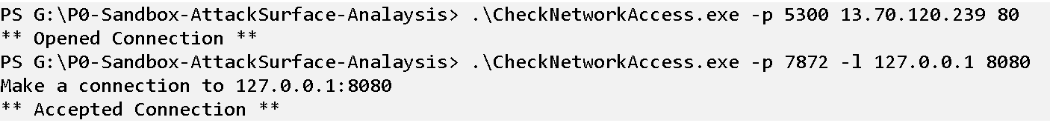
Network sockets
A Low IL process can create a network socket, as can an AppContainer which has been given a network capability
This essentially allows an attacker to connect out or bind a local listening socket and serve as a network pivot to perform other attacks
Can be useful for reaching local attack surface that isn’t reachable via the web browser without a web control bypass

Slide 43
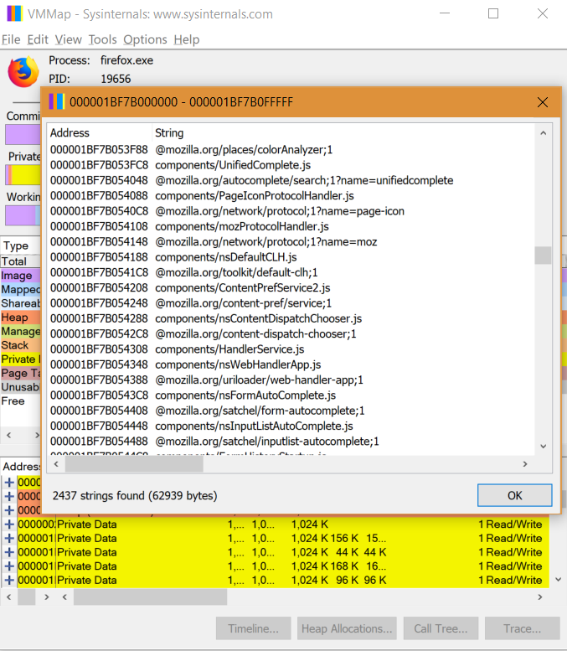

Files, Registry, Sections, etc.
Remember – the sandbox won’t protect you with file-systems that don’t support a security descriptor – e.g. a FAT-based thumb-drive
The ability for Low IL processes to access other Low IL process resources can be problematic too – such as shared memory being exposed
Files, Registry, and Sections may have had AddRule() policies allowed to get a sandbox to work and is worth manually auditing

Slide 44

Processes, Handles, Tokens
Get-AccessibleProcess for showing access to other processes while impersonating a sandbox
Useful if you can compromise a Low IL process and the system has other applications running as Low IL – e.g. Electron applications and GPU processes
Get-AccessibleHandle is useful for seeing what a process has open and checking the DifferentAccess flag when a handle is shared between processes
See Firefox GMP sandbox escape by Nils
There is a whole lot of crazy uncovered by Forshaw in Windows
Recommend watching Abusing Access Tokens talk

Slide 45
3. SBX via Browser IPC

Slide 46
renderer
chrome.exe
gpu
widevine
OS
Browser
Sandboxes

Slide 47

Mojo IPC
The “new” platform-agnostic IPC mechanism for Chromium
Supports a message Interface Description Language (IDL)
Supports a bindings library to get code generation for many target languages

Slide 48



Attack 1 - Renderer to Browser
Mojo IPC interfaces and methods can become complex
Not correctly binding data-types
Integer and buffer issues
Protocol mishandling, etc.
In particular, Use After Free lifetime conditions can be hard to find, but high very impact vulnerabilities
Recommend reading Mark Brand – Virtually Unlimited Memory

Slide 49
Renderer to Weaker Sandbox
The parent Browser process is the most appealing attack surface
Remember – there is also a GPU process, plugin processes (Widevine, PlayReady, PDF, etc.)
Mojo IPC is used to provide interfaces between the renderer process and other processes – there is minor attack surface
But, GPU and CRM/DRM sandboxes do not have Win32k lockdown…

Slide 50
Finito

Slide 51
Takeaways
Google and Microsoft have worked together quite well to get to a point where Chromium and Windows 10 can create a decent sandbox
Windows 10 implements a number of decent mitigations but also implements controls to protect sandboxed processes from known problematic attack paths (e.g. symlinks, KASLR leaks, etc.)
Chrome is well out in front, with the new Edge generally on-par with its sandbox policies and looking promising
Firefox has some improvements on the way which shows the engineering feat, win32k lockdown and untrusted IL hopefully soon
Processes such as GPU have a smaller attack surface but a weaker sandbox

Slide 52
Predictions
Mojo IPC will remain a ripe attack surface for awhile, in particular renderer to browser UaF’s
Other Mojo IPC to GPU/CRM plugins will have limited attack surface but high reward due to Win32k access
Same Origin Policy bypasses and Universal XSS vulnerabilities may get more valuable to reach more fragile browser attack surface
Attacking popular applications that bind to localhost via the browser

Slide 53

And if you want to learn more…

Slide 54
Thanks!

